Slide 1

SMART GAMLA
Using soil moisture sensor ,Water
level sensor and humidity
sensor

Slide 2


can we live without plants?

Slide 3
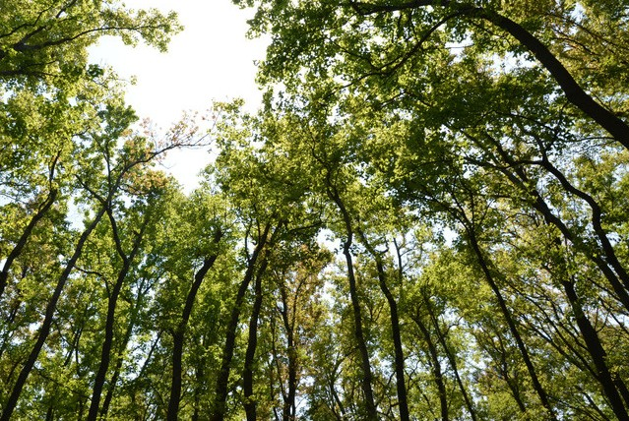
Life on Earth depends on plants, algae and fungi. For humanity, all seven billion of us, they are the major source of food, clothing, shelter and medicine.

Slide 4

How do plants help the Earth?

Slide 5

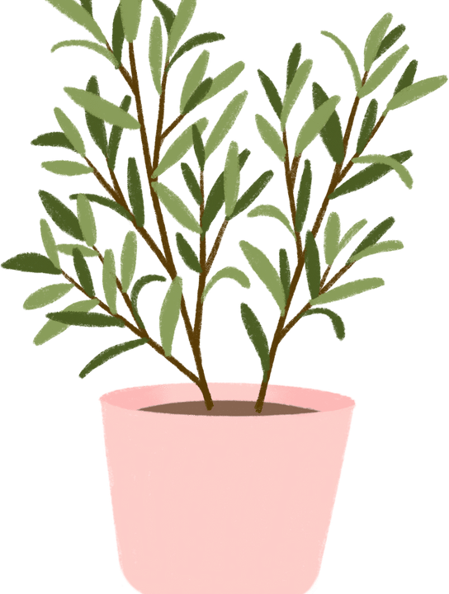
produce oxygen and absorb carbon dioxide during photosynthesis.
Oxygen is essential for cellular respiration for all aerobic organisms. It also maintains the ozone layer that helps protect Earth's life from damaging UV radiation. Plants recycle matter in biogeochemical cycles.

Slide 6
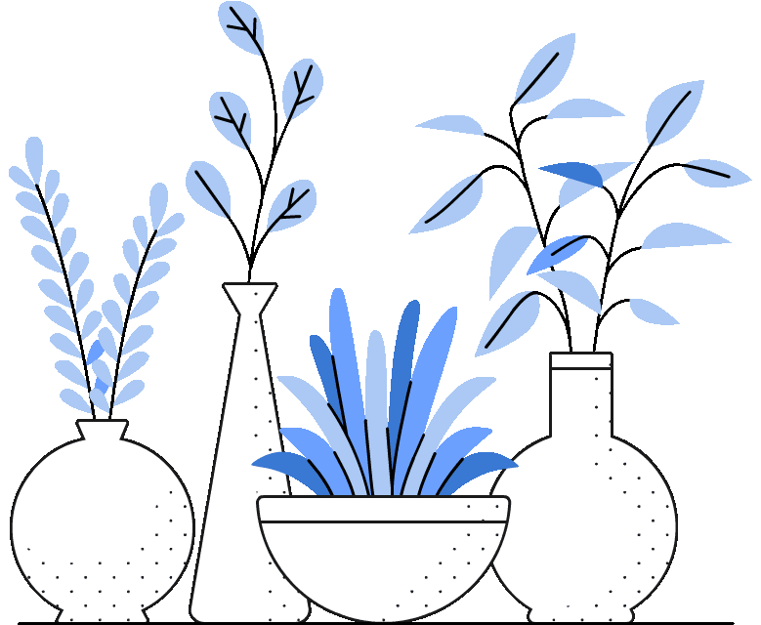
Why is important to pot plants?

Slide 7

Going the container route saves space, helps control pests and overcome soil issues, enabling the availability of home grown fresh produce without a yard

Slide 8
Why to pot plants?

Slide 9
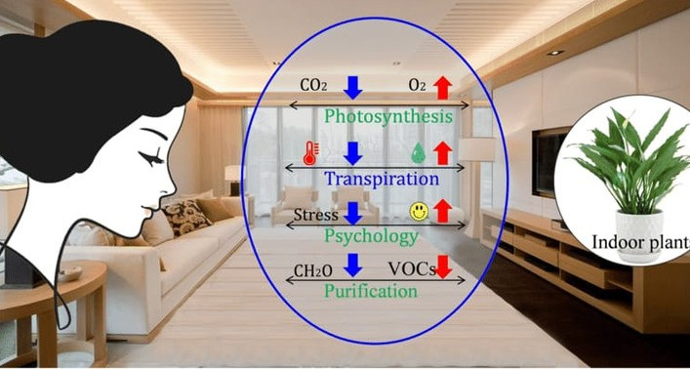

Slide 10




Having plants in your home or office can be a source of pleasure. Indoor gardening relieves stress, boosts creativity, productivity, and focus, and promotes recovery. There's some evidence that houseplants may positively influence the air quality in your home as well.

Slide 11
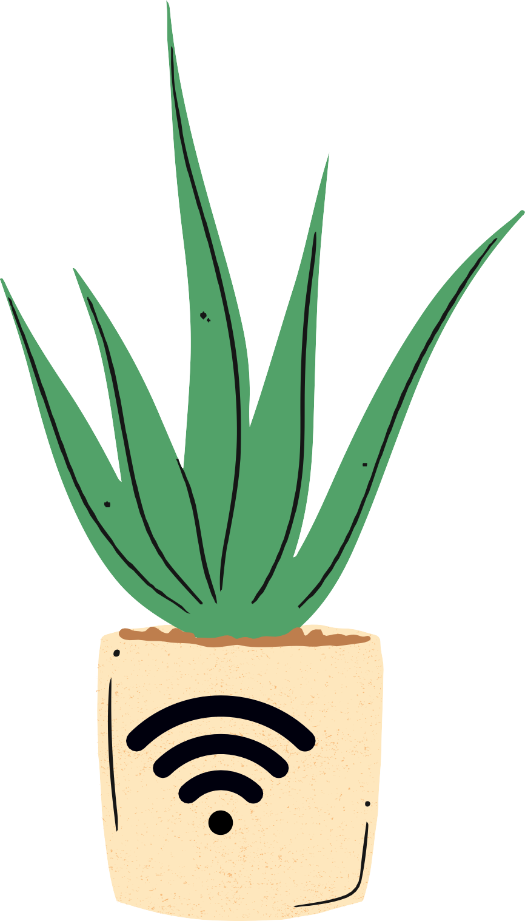
Why smart-pot?

Slide 12

The large bottom of a Smart Pot makes them suitable for growing huge plants, which explains why Smart Pot containers can be found in large sizes compared to regular plant containers. Giant indoor plants won't topple over in a good Smart Pot

Slide 13
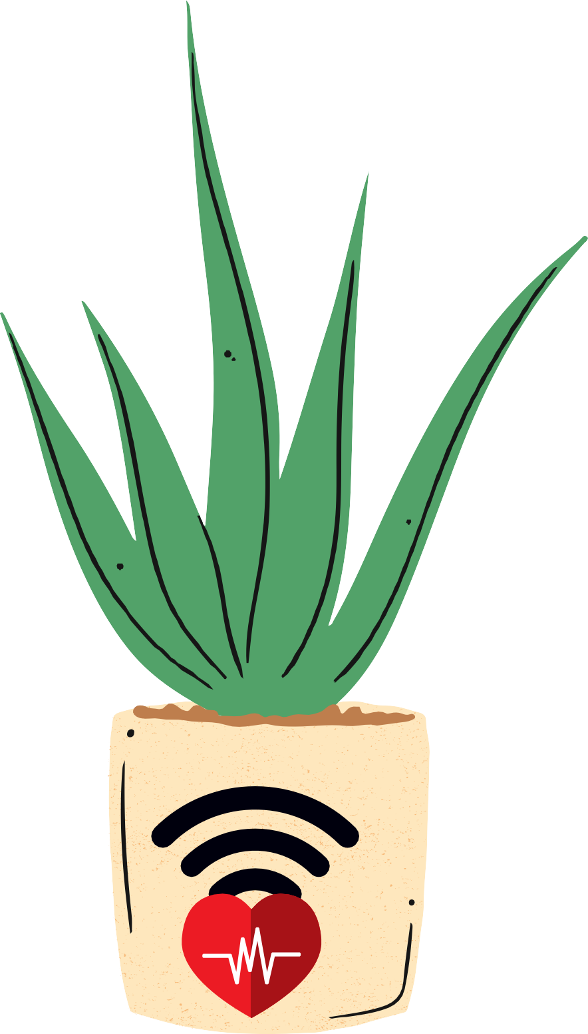
Life of smart pot?

Slide 14
Smart Pot containers are reusable and last multiple seasons. While the expectant life span is at least 3-5 years, many customers are still using their Smart Pot planters a decade later.

Slide 15
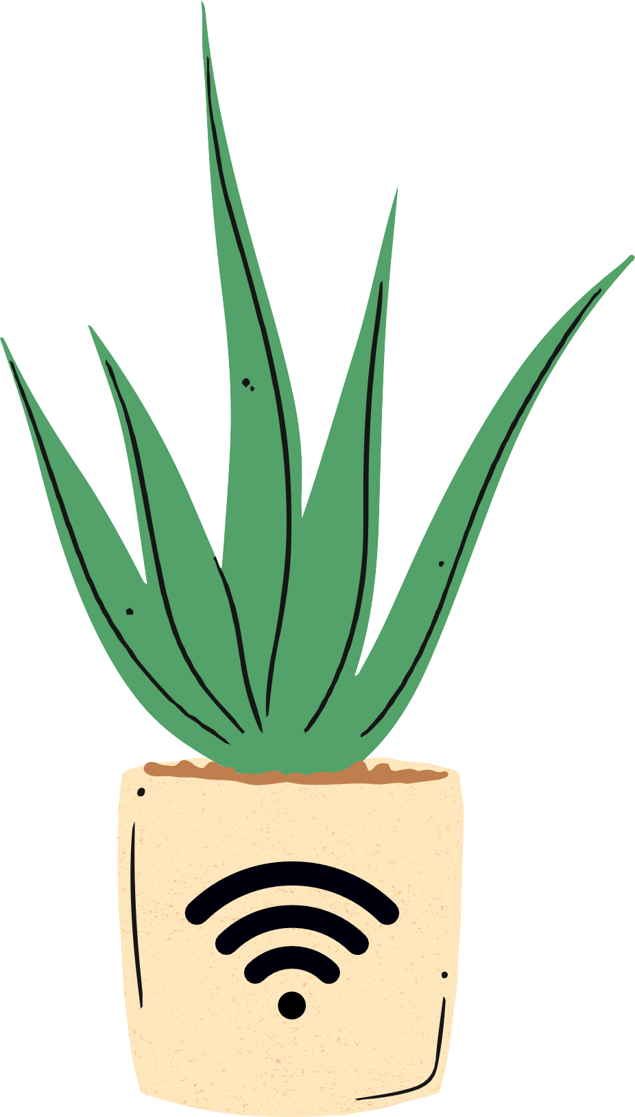

Drawacks of smart pot?

Slide 16


Pots are very fragile and Since the pot is quite heavy, moving is also more difficult.
While both plastic and fabric pots are reusable, plastic pots typically won't maintain their quality for as long as fabric pots. The material that makes up a fabric pot may stretch and wear with time, but it will last longer than a plastic pot which will eventually crack or break.

Slide 17

Overcoming Drawacks of smart pot?

Slide 18
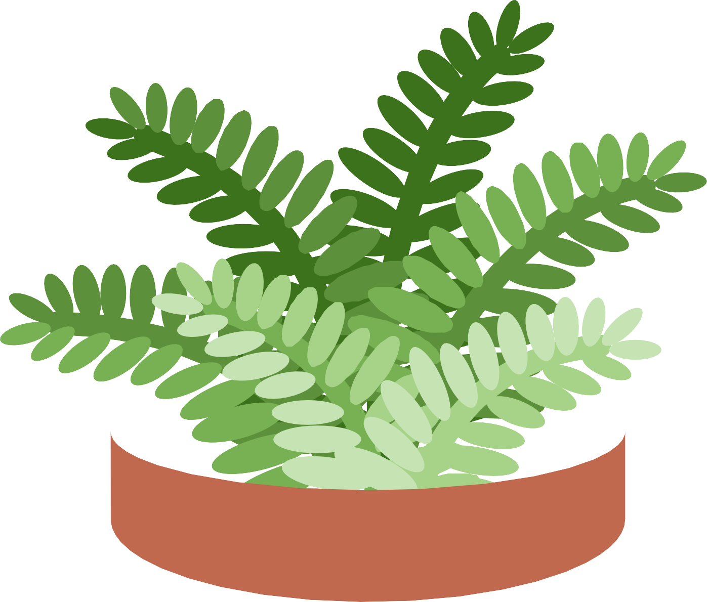

Normal growing containers do the trick, but Air-Pots and Smart Pots offer so many benefits that it just makes sense to use them.
These genius designs boost root system oxygenation, support optimal drainage, and even help prevent root diseases and decay.

Slide 19
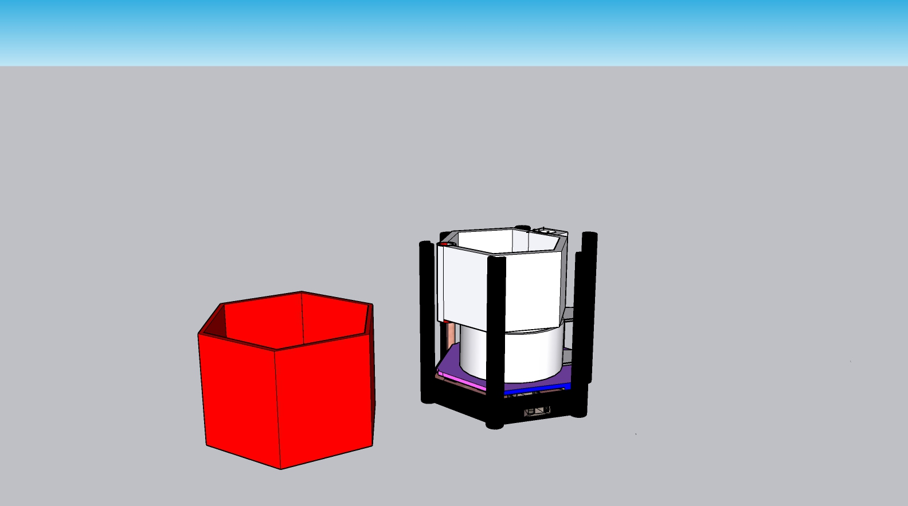
Designing of smart pot?

Slide 20
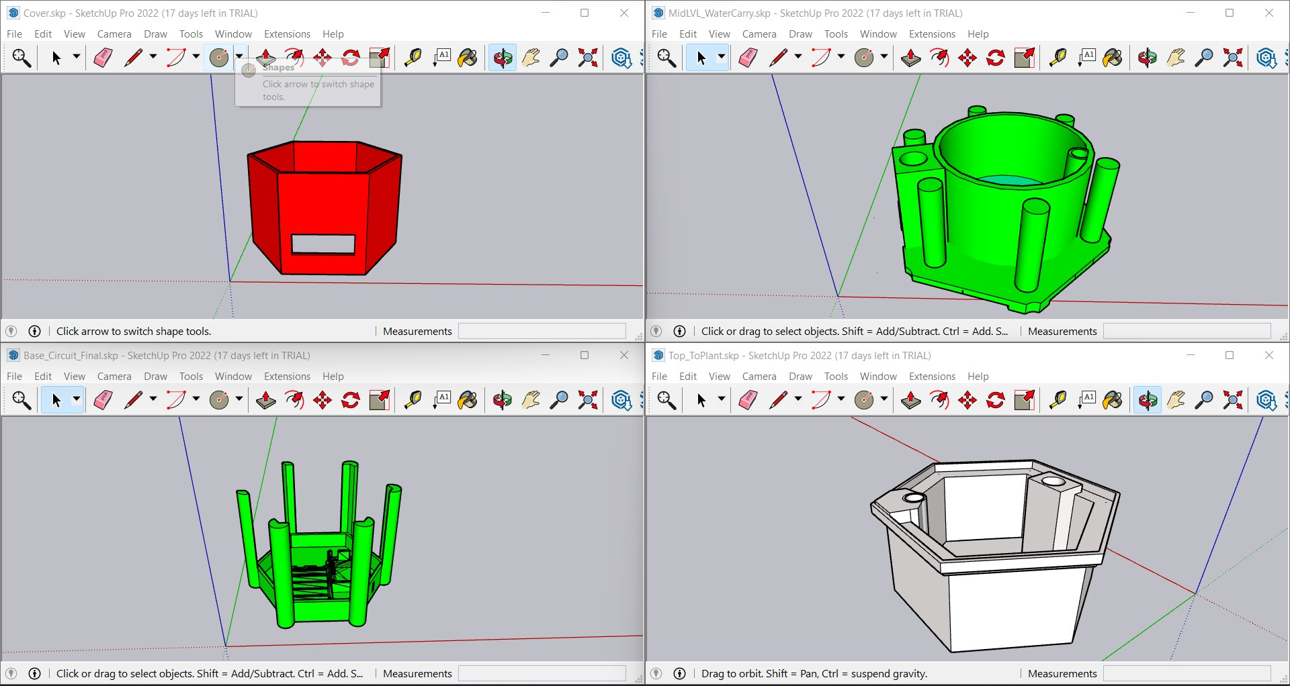

Slide 21
How did we design this pot?
Actually , designing this pot was actually more messier then it looks cause each time we came up with some ideas , with each ideas came the issues like dimension mismatch of components or looks were not that cool or great and many more …Then suddenly we popped with idea of designing individually and then comparing each design with other and ask to Anupam sir for his opinion about which designed looked better , in which my ( Vishwas verma ) design was selected and then again we had to start from the basic core till now . Now as you may know this pot performs various tasks and so it requires different layers as well as different components , accordance to which we had to give sections so that we may get the output we are expecting . And then finally our model which we made layer by layer was obtained . Well to be frank this model literally made us cry a lot but when we achieved the success we were just as happy as when we were sad…

Slide 22
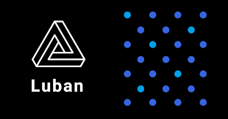


Software’s used:-
SnapMaker Luban
FlashPrint
For designing we used 3d designing software like sketch up pro and fusion 360.
While sketch-up pro used basic commands to achieve our goal till what it was best at and then for final touch we used Fusion 360 that was a level above to what sketch up was .
And before printing the conversion of our design from its virtual form to printable form took place cause each device read their own special g code generated by different software’s . We used Flash-print , Snap_maker Luban and Simplify 3d.

Slide 23
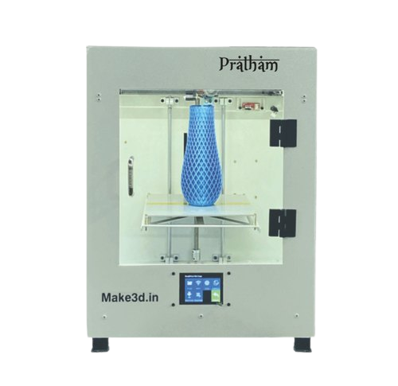
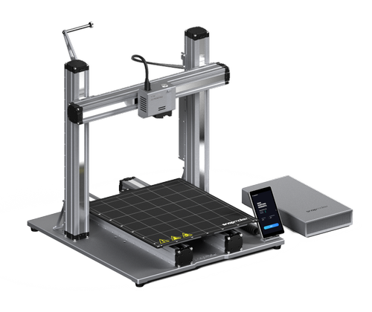
Device Used:-
Pratham
After designing and finalizing the Gcodes , We moved to the final part under designing team that is to opt the device for printing the model in accordance to its dimensions and Gcode .
So her for Base layer and The cover layer we used Snapmaker for which we used Snapmaker luban (Software) and then for water storage and top layer we used Pratham (device) for what we used Simplify 3d software.
SnapMaker Luban

Slide 24
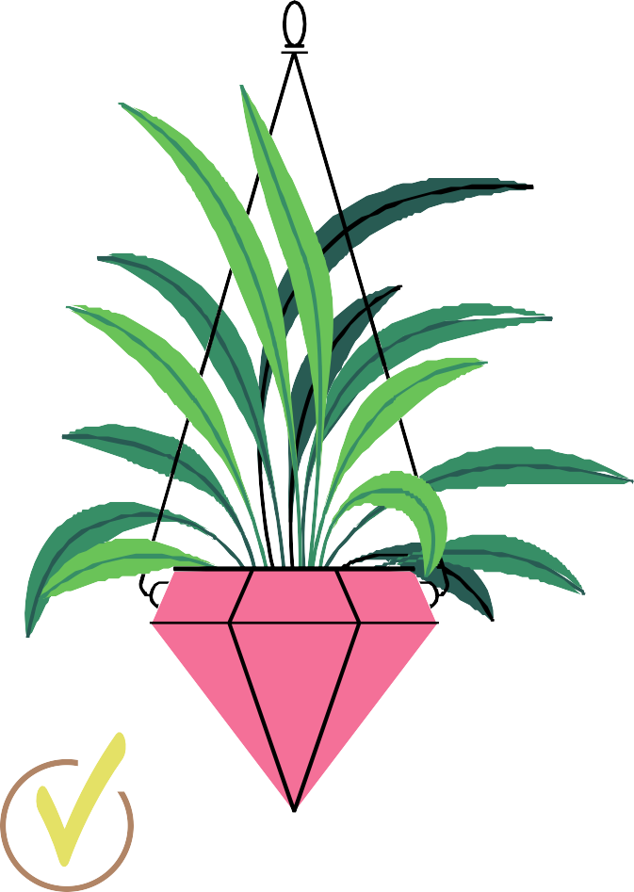
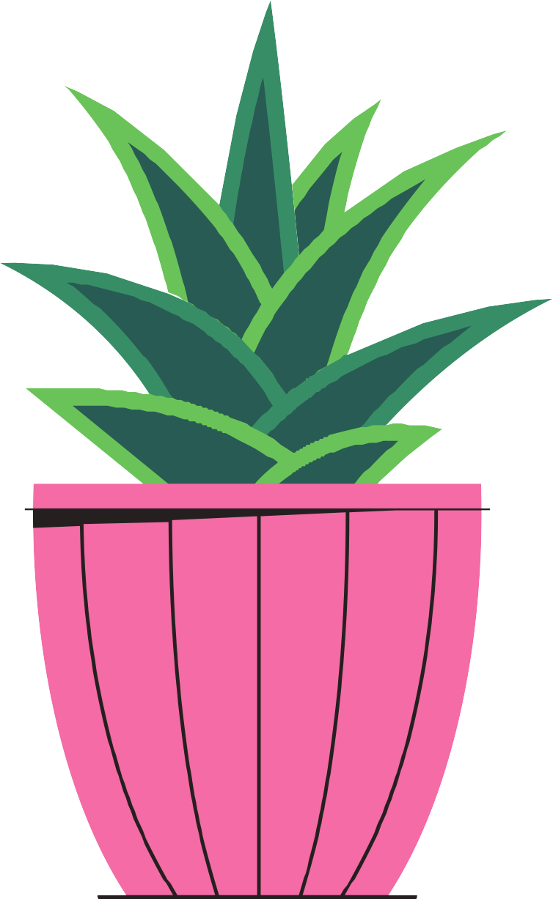
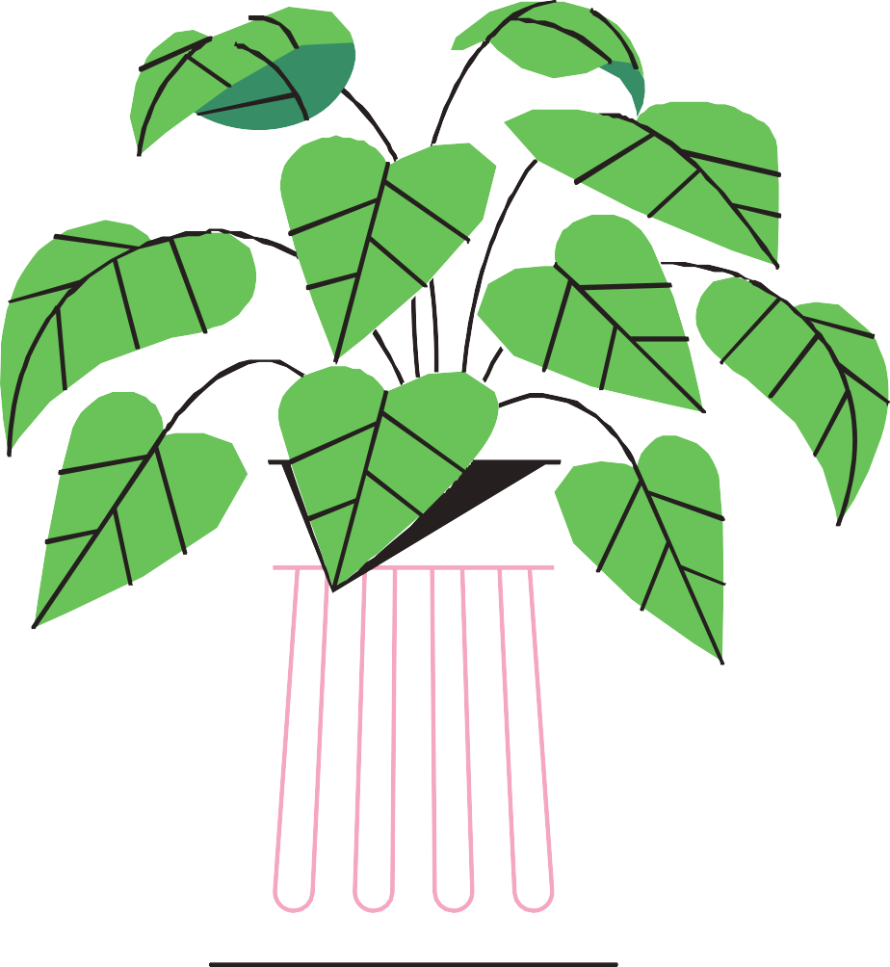
Thank you
For Listening about our project in detail
Please ask any queries from us

